Slide 1
Welcome to PharmD Open House
Teresa Cavanaugh, PharmD, MS, BCPS
Assistant Dean for Student Affairs

Slide 2
Schedule for the day
1:00 Welcome / Curriculum Overview
1:20 Pre-Professional Courses/Admission Criteria/Application Procedures
1:50 Careers in Pharmacy
- Faculty Panel
2:20 Student Life Panel
2:45 Making Yourself Competitive for Pharmacy School Admission
3:00 Guided Tours & Advising
3:15 Dessert Reception

Slide 3
What do you think about when you think of a pharmacist?

Slide 6
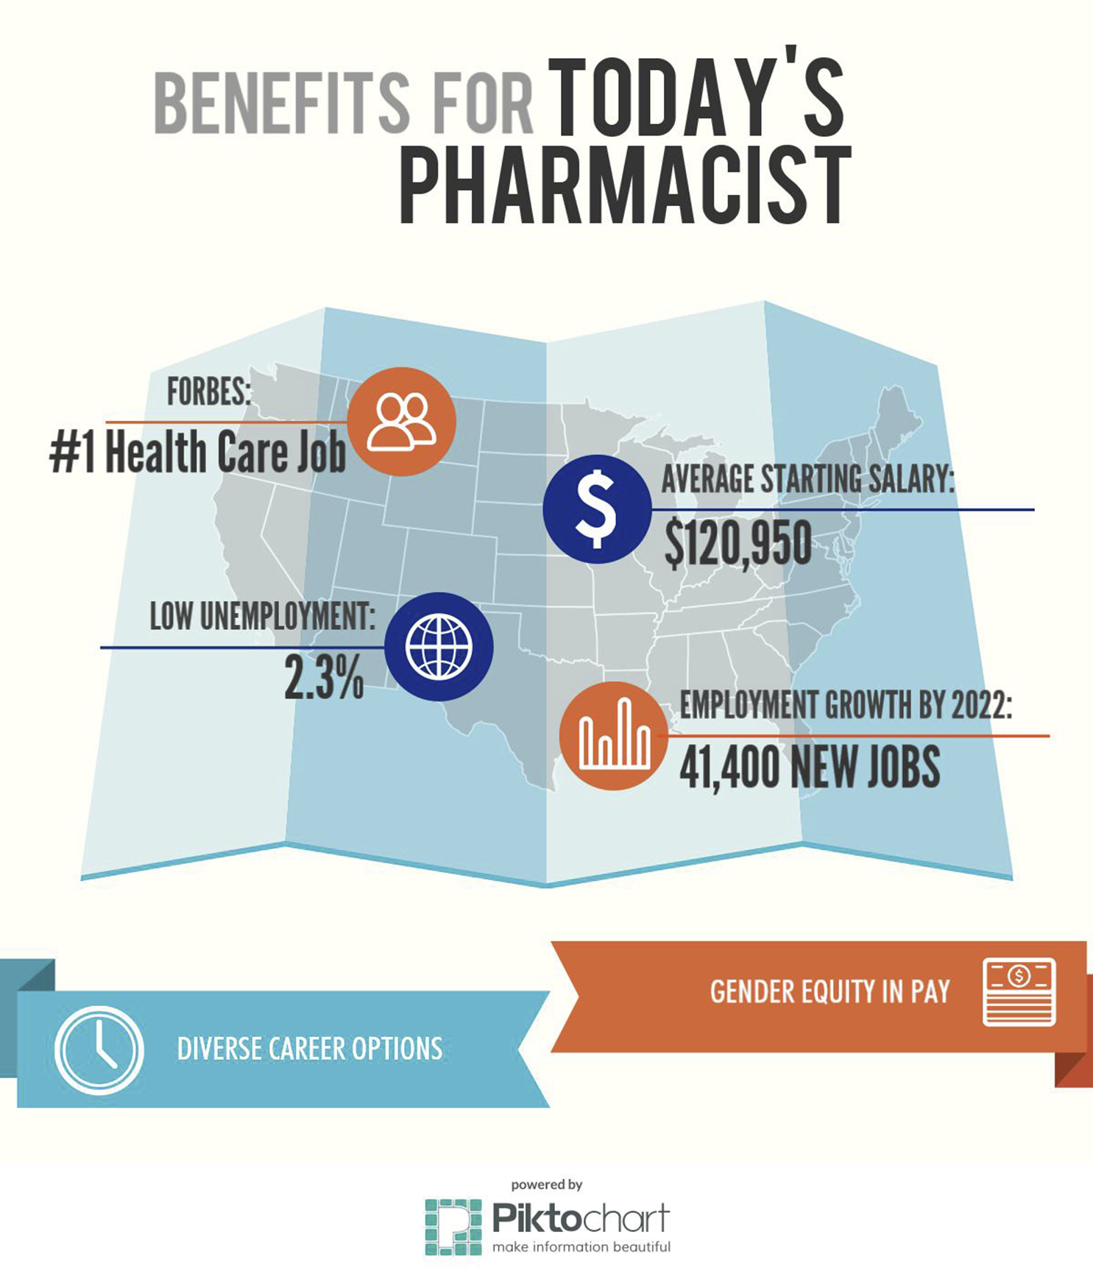

Slide 7
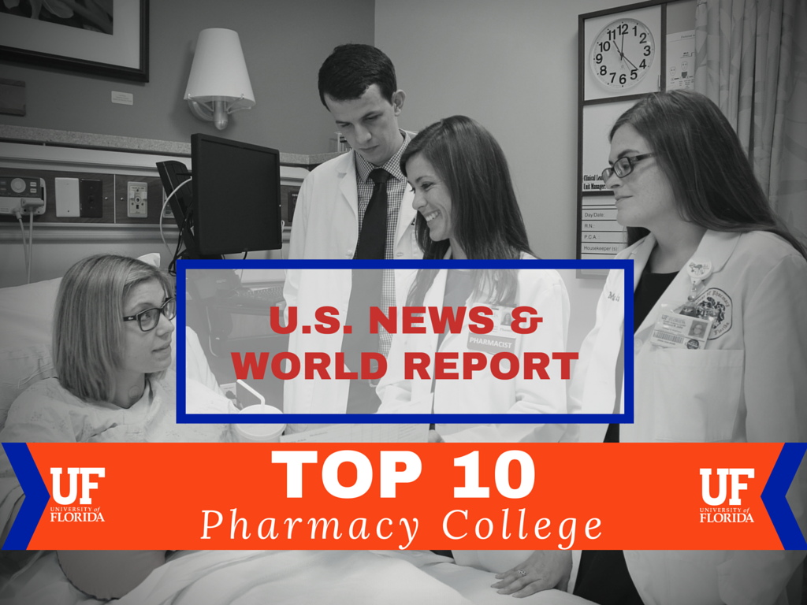

Slide 8
What makes us “Top 10”?
Active, award winning student organizations
Health Science Center
Only AHC with 6 health-related colleges located on a single, contiguous campus
Innovative Pharm.D. curriculum with an integrative design to promote greater student learning and achievement of quality educational outcomes

Slide 9
What makes us “Top 10”?
Innovative Pharmacy Practice
Preeminent faculty / extraordinary staff
Top of their license
Ambulatory care, infectious disease, pediatrics, critical care
Medication Therapy Management Communication and Care Center

Slide 10
What makes us “Top 10”?
Strong alumni support
> 12,000
Quality experiential education program across the state of Florida and in selected sites in other states and Europe
Top quality research experiences for pharmacy and graduate students

Slide 11
What makes us “Top 10”?
Internationally recognized research
> $14 million in research awards
4 research centers
Pharmacogenomics (Personalized Medicine)
Natural Products
Pharmacometrics and Systems Pharmacology
Food Drug Interaction Research
DAYS
Days

Slide 12
What does it mean to you that we are Top 10?
Environment
Capacity
Engagement
Outcomes

Slide 13
UF Pharm.D. Curriculum
Builds strengths that prepare you for career success
Become a collaborative healthcare team member
As the team’s pharmacist, you will be respected for your contributions to patient care
Solve the most challenging problems in practice
Learn an evidence-based problem-solving approach
Lead change
The pharmacy profession and the US healthcare system are changing and leaders are needed

Slide 14
UF Pharm.D. Curriculum
Become a respected healthcare professional
Develop high personal standards for practice
Develop a unique set of skills known to enhance an individual’s career. For example:
Innovative mindset
Self-directed learner
Effective communicator during difficult conversations
An advocate for patients and the pharmacy profession

Slide 15
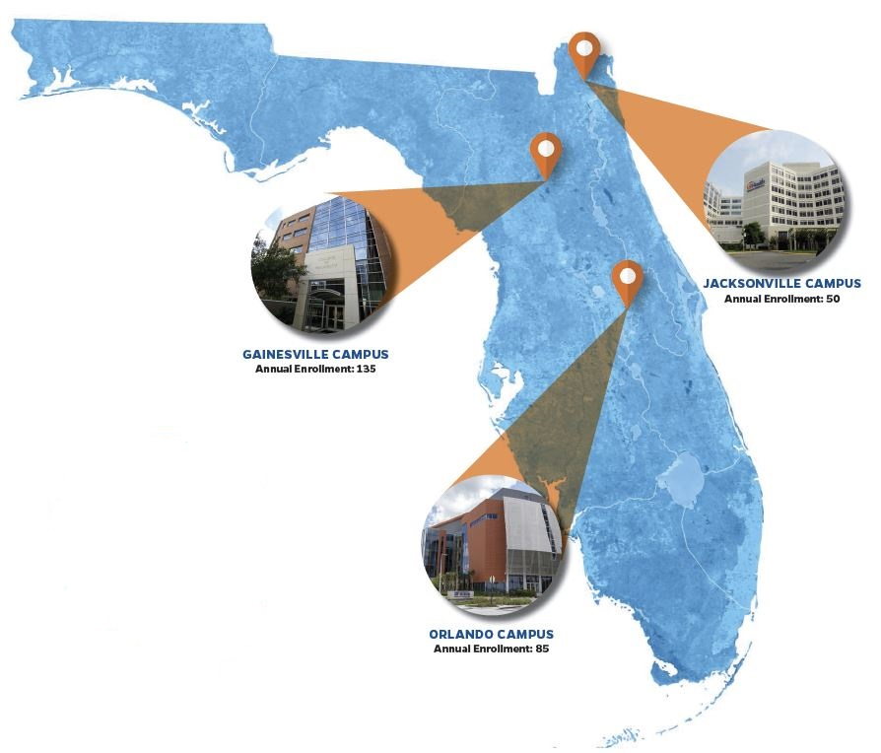
Learning is the Same on All Campuses

Slide 16
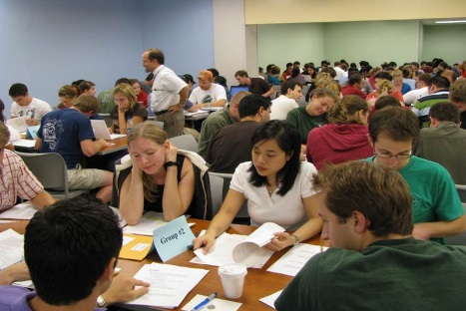
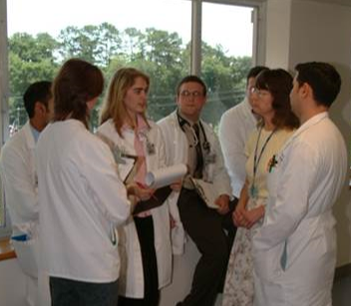
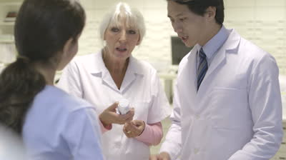
Pharm.D. Curriculum
Year 1
Foundations for practice
Years 2 and 3
Learn in the context of patient care
Year 4
Demonstrate in practice
Develop foundational knowledge and skills.
Expand and apply your pharmacy knowledge & skills
Perform pharmacist responsibilities in actual practice
Introductory Practice Experiences –
community hospital
Continuous Professional Practice Skills laboratories–
perform practice tasks and learn through feedback
Co-Curriculum & Continuous Personal and Professional Development
prepare for career success

Slide 17
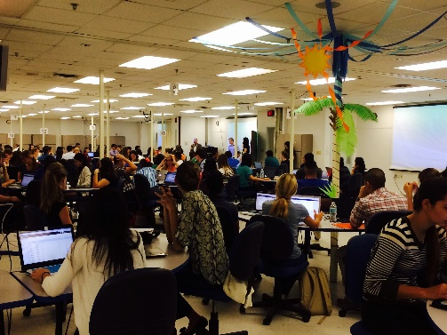
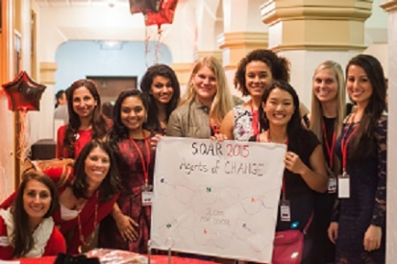
How You Will Learn: Blended Learning
Online/Independent Study
Face-to-Face Classroom Learning
Video lectures
Online modules
Virtual simulations
Collaborative learning in teams
Skills Laboratory
Electronic Medical Records
Co-Curricular Activities
Experiential Learning
Health Screenings
Professional Organization Activities
Cultural experiences

Slide 18
UFRx PharmD – 1PD
Aug |  | Sept |  |  |  | Oct |  |  |  | Nov |  |  |  | Dec |  |  |  | Jan |  |  |  | Feb |  |  |  | March |  |  |  |  | April |  |  |  | May
1 | 2 | 3 | 4 | 5 | 6 | 7 | 8 | 9 | 10 | 11 | 12 | 13 | 14 | 15 | 16 | 17 |  | 1 | 2 | 3 | 4 | 5 | 6 | 7 | 8 | 9 | 10 | 11 | 12 | 13 | 14 | 15 | 16 | 17 | 18
ORIENTATION | Principles of Patient Centered Care Communication, Pharmaceutical Care, patient workup, Informatics & Patient Safety 2 Cr Hr |  |  |  |  | Pathophysiology & Patient Assessment I 3 Cr Hr |  |  |  |  |  |  |  |  |  | Personal Development/Remediation | Semester Break | Pathophysiology & Patient Assessment II 3 Cr Hr |  |  |  |  |  |  |  | Spring Break | Patient Care 1: Integrated Module on Self-Care, OTC, drug supplements/herbals, etc. 3 Cr Hr |  |  |  |  |  |  |  | Capstone Assessment /Remediation | Community IPPE/ Remediation/Summer Break
 | Population Health Social determinants of health, health dispari-ties, wellness strategies 2 Cr Hr |  |  |  |  | Principles of Medicinal Chemistry and Pharmacology I Principles of medicinal chemistry and pharmacology. Structure Activity Relationships; Molecular and cellular mechanisms of action. 3 Cr Hr |  |  |  |  |  |  |  |  |  |  |  | Principles of Medicinal Chemistry and Pharmacology II Principles continued. 1 Cr Hr |  |  |  |  |  |  |  |  | Principles of Evidence -Based Practice Biostatistics; health Information retrieval and evaluation; literature evaluation; evidence-based medicine/pharmacy . 3 Cr Hr
 | Personal & Professional Development I Critical Thinking, Problem-solving, Interprofessional - Collaborator Self-Awareness, Patient Advocacy; Leadership; Innovation; Educator; 1 Cr Hr |  |  |  |  | Drug Delivery Systems Drug formulations, as well as devices used for drug delivery and targeted drug delivery. 4 Cr Hr |  |  |  |  |  |  |  |  |  |  |  | Principles of Drug Therapy Individualization Mechanisms underlying variability in drug response. Includes principles of biopharmaceutics, pharmacokinetics, and pharmacogenetics, Special populations 4 Cr Hr |  |  |  |  |  |  |  |  | Principles of Systems- Based Practice Health care delivery systems including Medication use systems (informatics & patient safety at the systems level). Insurance and assisting patients with coverage issues 1 Cr Hr
 |  |  |  |  |  |  |  |  |  |  |  |  |  |  |  |  |  | Personal & Professional Development II Principles of Law and Ethics 1 Cr Hr |  |  |  |  |  |  |  |  | Personal & Professional Development II Continued.
 | Interprofessional Education – IFH: A requirement of the Personal and Professional Development Courses; Hours count towards IPPE. |  |  |  |  |  |  |  |  |  |  |  |  |  |  |  |  | Interprofessional Education – IFH – ongoing
 | Professional Practice Skills I (1 Cr Hr): Patient interviewing, communications, patient assessment, compounding. |  |  |  |  |  |  |  |  |  |  |  |  |  |  |  |  | Professional Practice Skills II (1 Cr Hr): Patient assessment, compounding, communications (continues), Drug Information, literature evaluation, patient self-care, dispensing, patient safety.
Milestone 1
Notes:
Fall = 16; Spring = 17

Slide 19
GatoRx Class of 2022
273
Students
83
Orlando
49
Jacksonville
141
Gainesville
Notes:
Updated 08.24.2018

Slide 20
GatoRx Class of 2022
Science GPA = 3.37 (mean)
Q1 = 3.09
Q3 = 3.72
76th percentile (mean)
Q1 = 66
Q3 = 90
76% of students have a B.S./B.A. degree
40% attended UF

Slide 21
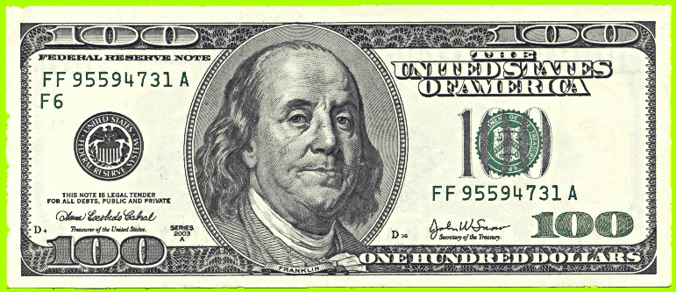
Scholarships for Admitted Students
> $200,000
Notes:
54 students were awarded a total of $126,500. 65 different scholarships were awarded to the students admitted in fall 2016.

Slide 22
Admissions
Tom Robertson, Ed.D

Slide 23
Admission Requirements
Pharmacy pre-reqs
General education coursework required by UF or AA degree
PCAT (http://pcatweb.info/)
Foreign language requirement
Holistic admissions https://admissions.pharmacy.ufl.edu/

Slide 24
Pre-Pharmacy Course Requirements
Chemistry
Gen Chem I and II w/labs
Organic Chemistry I and II w/labs
Biochemistry
Biology
Biology I and II w/labs
Microbiology
Anatomy and Physiology I and II w/labs
Mathematics
Analytical Geometry with Calculus I
Statistics

Slide 25
Application Process
Step 1: PharmCAS (http://www.pharmcas.org/)
PCAT scores
Official Transcripts
Two letters of recommendation
Step 2: University of Florida
After invited for interview, complete online application for UF
http://www.admissions.ufl.edu/apply/professional
Deadline for Fall 2019 applications is Feb 1, 2019
The earlier the better!
Early Decision!
Admission to preferred campus more likely prior to Dec 31.

Slide 26
Request the Info Session Slide Set
If you would like access to these slides, please go to:
https://admissions.pharmacy.ufl.edu/
Select “Why UF Pharmacy” and then on left, click on ‘Information Sessions.”

Slide 27
Pharmacist Panel
Jason Powell
Lindsey Childs-Kean
Teresa Cavanaugh

Slide 28
Student Life Panel
Victoria Grusauskas (1PD)
Solmaz Karimi (2PD)
Hemita Bhagwandass (1PD)
An Phan (1PD)
Keegan McCauley (1PD)

Slide 29
Contact Information
www.admissions.pharmacy.ufl.edu
Phone – 352-273-6217
Dr. Teresa Cavanaugh– Assistant Dean for Student Affairs (TCavanaugh@cop.ufl.edu)
Dr. Tom Robertson – Associate Director, Admissions and Recruiting (tarob@cop.ufl.edu)
Wanda Washington – Academic Advisor for UF students (wanda@cop.ufl.edu)
Mary Beth Yokomi – Admissions Officer (Yokomi@cop.ufl.edu)

Slide 30
Are you ready to be a Gator RPh?

Slide 31
Making Yourself Competitive for Pharmacy School Admission
Teresa M. Cavanaugh, PharmD, MS, BCPS
Assistant Dean for Student Affairs
Clinical Associate Professor

Slide 32
Objectives
Identify characteristics important for being a pharmacist
Describe ways that you can demonstrate these characteristics in your pharmacy school application

Slide 33
What are we looking for?

Slide 34
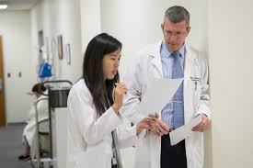
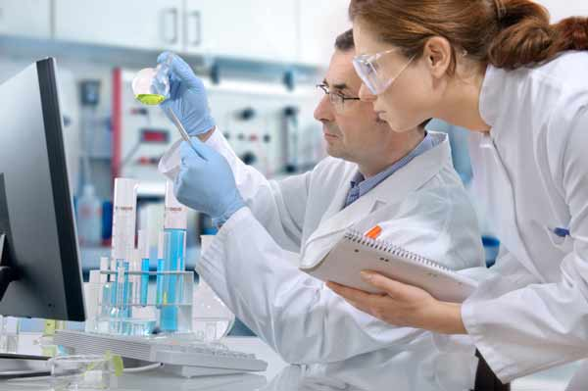
A Pharmacist in the Making

Slide 35
Holistic Admissions Process
Flexible
Individualized
Experiences
Attributes
Academic Metrics
You and the
Profession of
Pharmacy

Slide 36
Characteristics of a Good Pharmacist
Communication skills
Interpersonal skills
Leadership skills
Analytic skills
A good memory
Conscientiousness
Counseling skills
Scientific aptitude
Interest in continuing education
Computer skills
http://pharmacyschools.com/resources/top-10-qualities-of-a-great-pharmacist

Slide 37
How Do You Demonstrate You Have Those Skills?
Take a few minutes to discuss some ideas with your neighbor

Slide 38
Communication, Interpersonal, Counseling Skills
Application Essays
Emails, phone calls
Interview
Behaviorally based questions
Presentations
Letters of recommendation

Slide 39
Leadership and Conscientiousness
Academic metrics
Organization involvement
Member
Active member
Leader
Position
Letters of Recommendation

Slide 40
Analytic Skills and Scientific Aptitude
Degree
GPA and Science GPA
Research Projects

Slide 41
A Good Memory and Computer Skills
Grades/Degree
Rigorous classes
Quality School

Slide 42
Interest in Continuous Education
How will we know?
You will tell us.

Slide 43
Other Attributes That Will Help You Be Successful at UF
Pharmacy experience
Ability to work on teams
Self-discipline
Perseverance
Altruism

Slide 44
Bringing It All Together
Do well in school
Get involved in organizations
Become a leader
Donate your time
Get pharmacy experience
Seek out research or project opportunities
Spend time on your application
Have someone proof-read for you

Slide 45
Making Yourself Competitive for Pharmacy School Admission
Teresa M. Cavanaugh, PharmD, MS, BCPS
Assistant Dean for Student Affairs
Clinical Associate Professor

Slide 46
Of the 140 colleges of pharmacy in the U.S., what is the ranking of the University of Florida College of Pharmacy?
a) # 14 in the U.S.
b) # 17 in the U.S.
c) # 1 in Florida
d) # 9 in the U.S.
e) None of the above
DAYS
Days

Slide 47
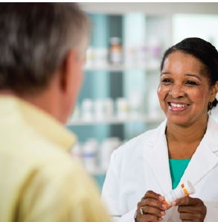
What You Will Learn:
Become a Pharmacist for the 21st Century
Medication Therapy Management
Transitions of Care
Medical Home Practice
Ambulatory Care (including Health & Wellness)
Traditional community & hospital practice

Slide 48
Graduating Class of 2017
270 students
35% residency/fellowship
49% employed in variety of pharmacy settings
3% unemployed
#1 in the U.S. for placing graduates into residencies
99 students

